Slide 1
Detecting Sarcasm on Reddit

Slide 2
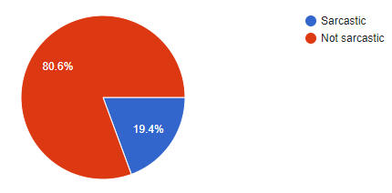

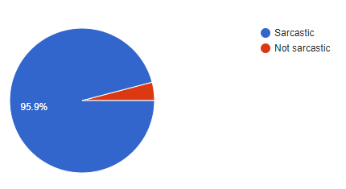
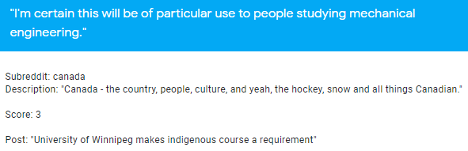
The Problem

Slide 3




The Human Result
Taking all questions into account*
Only questions with full context

Slide 4
Related Work
MIARN - Tay et al. (2018)
Multi-dimensional Intra-Attention Recurrent Network
Focuses on the semantics between each word in an input
For Reddit, produces F₁ score of ~0.69
CASCADE - Hazarika et al. (2018)
ContextuAl SarCasm DEtector
Focuses on establishing users’ personality to inform decisions
Without these features, produces F₁ score of 0.66; with, produces F₁ score of 0.77
thesarcasmdetector.com - Cliche, M. (2014)
Web-based app trained from Twitter
Uses suite of open-source libraries to make a lightweight web app
Produces F₁ score of 0.60 – for many reasons my project is best compared to this one

Slide 5
Data Collection
Self-Annotated Reddit Corpus (SARC) - Khodak, M., Saunshi, N., & Vodrahalli, K. (2017)
Full scope: 1.34m sarcastic comments of 533m total
Subset used: 50,000 comments
Provides access to subreddit and parent post – useful for contextual information

Slide 6







Pipeline
Processed data
Training data
Training
Feature extraction
Topic modeller
Test data
Classifier

Slide 7
Classifier Experiments

Slide 8
Classifier Statistics
Logistic Regression machine over a corpus of 50,000 comments
F₁ scores:
Sarcastic: 0.66
Non-sarcastic: 0.67
Target was 0.60 – from this metric the project is a success; competes with MIARN

Slide 9
Reddit Bots
Automated user accounts
Can post submissions and comments just like normal users
May be fully autonomous or respond to summons by users

Slide 10
Demonstration

Slide 11
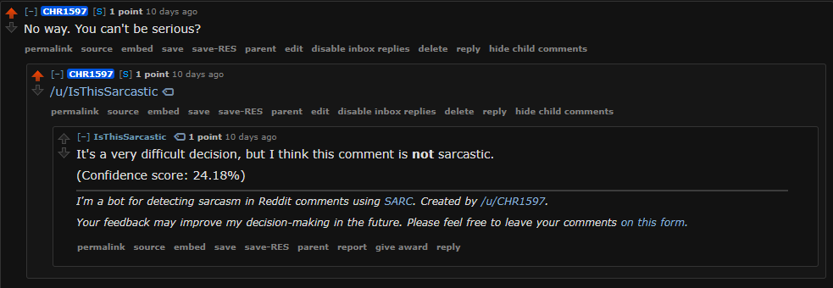
Usage Example for Sarcasm Detector Bot

